Slide 1



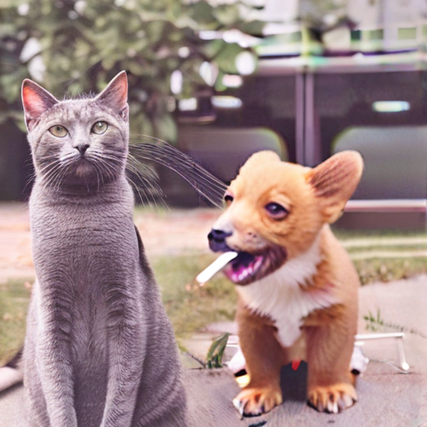
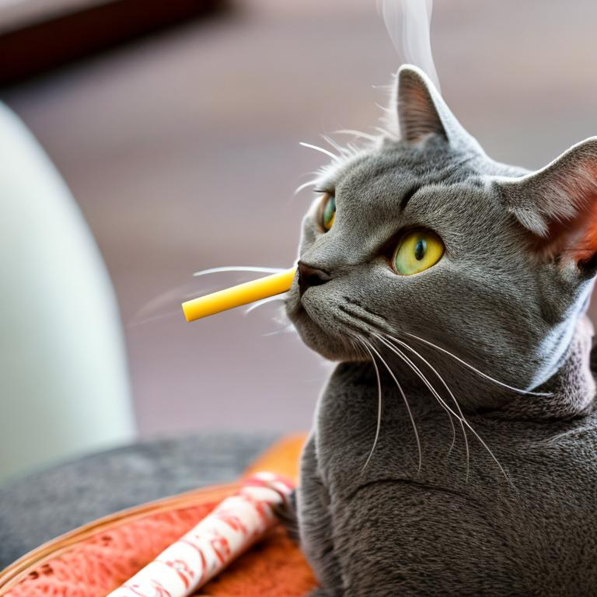
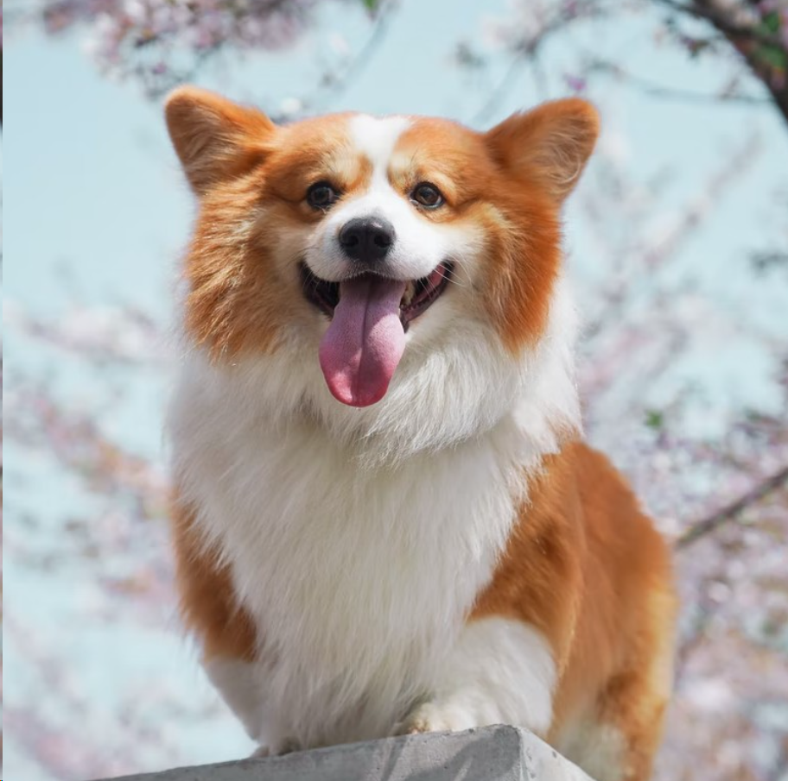
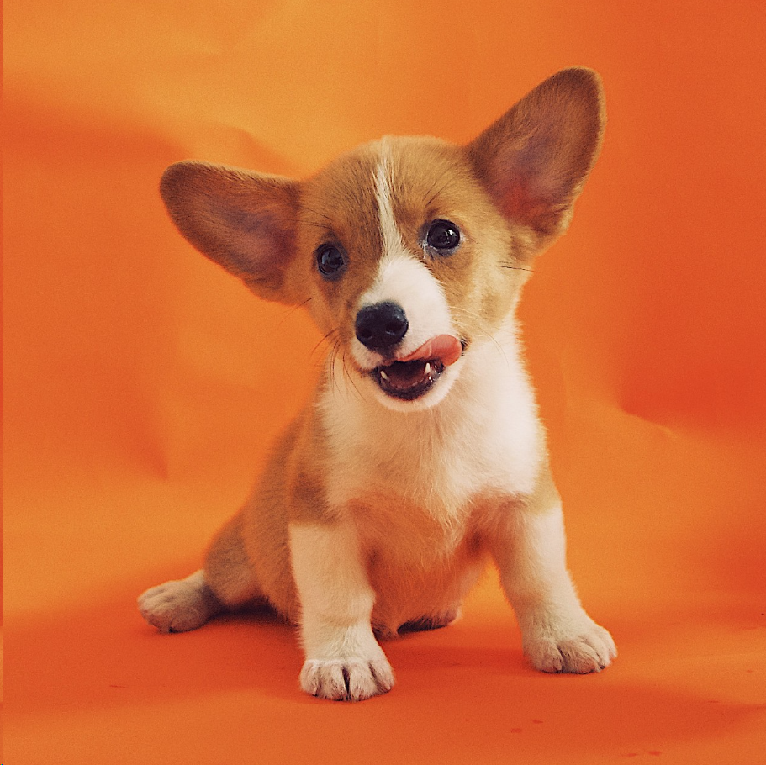
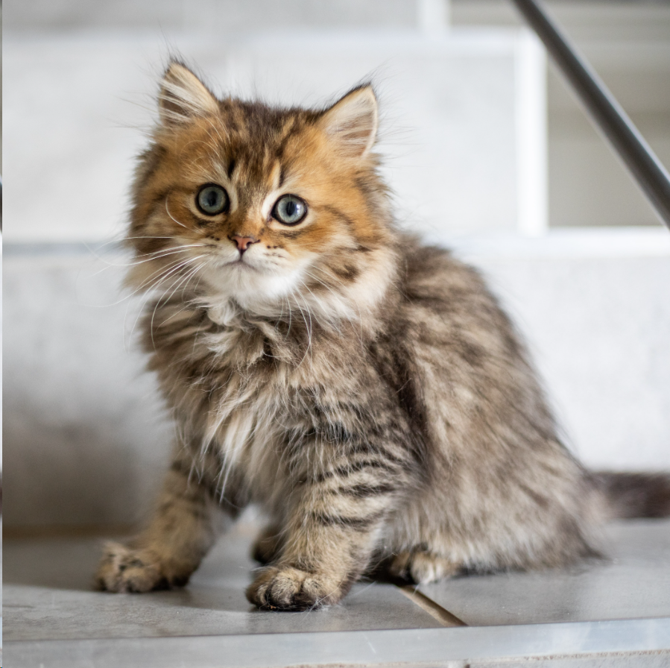
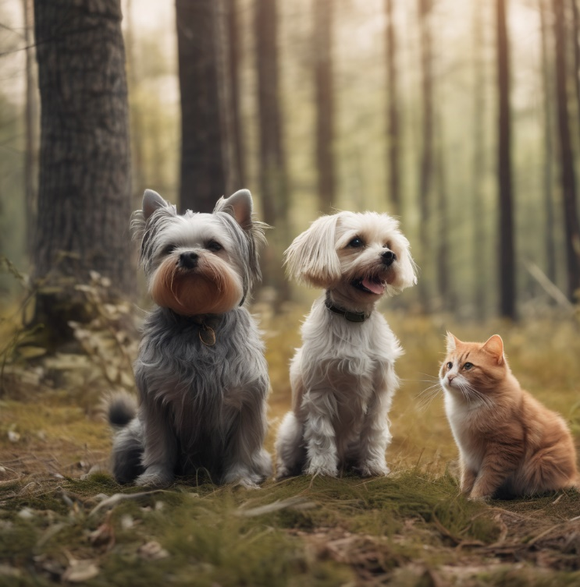


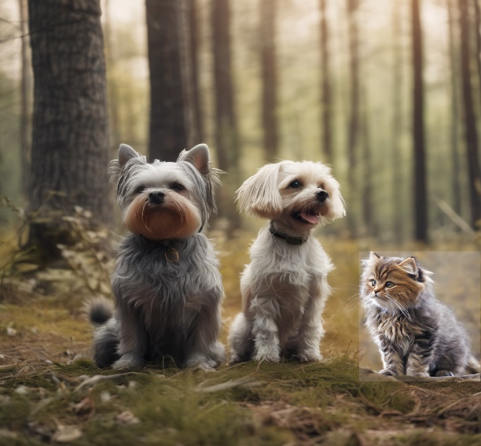
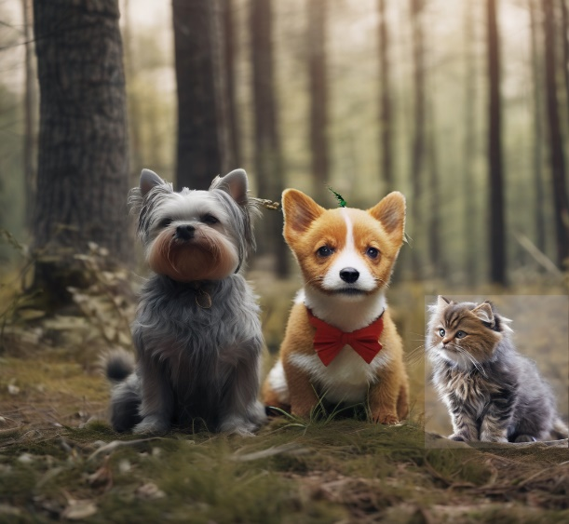
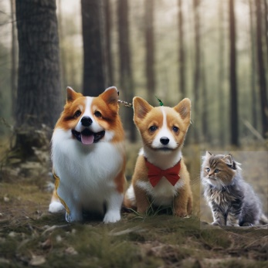

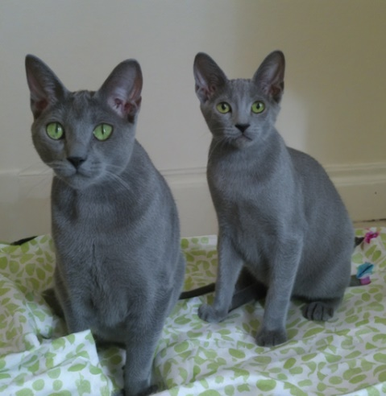
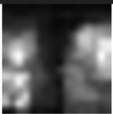
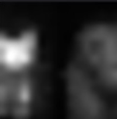

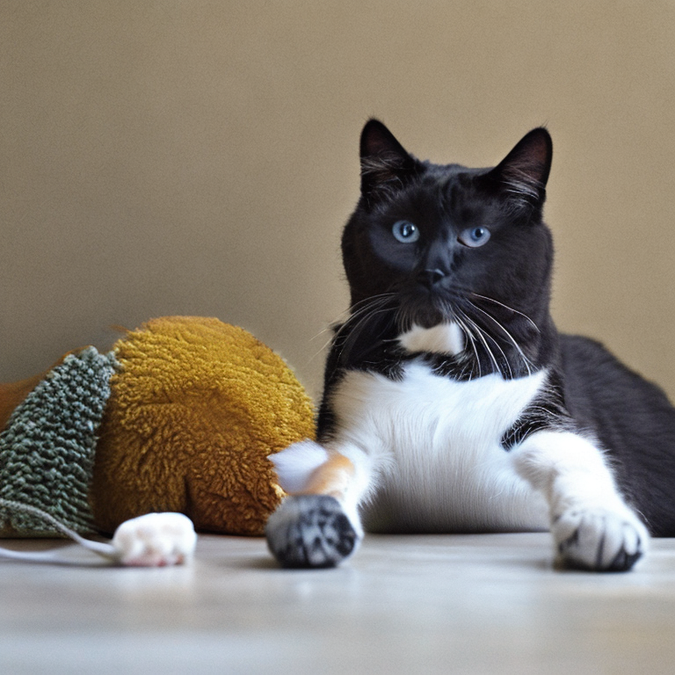
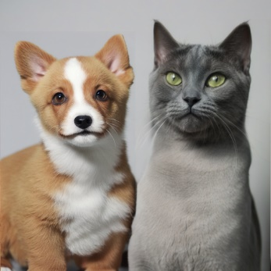

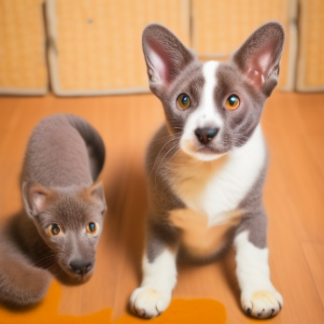
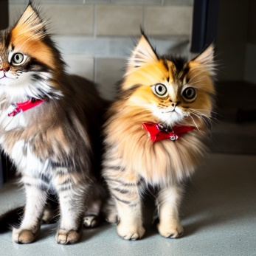
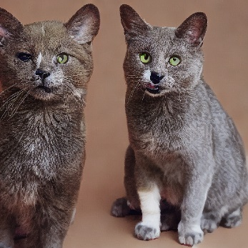
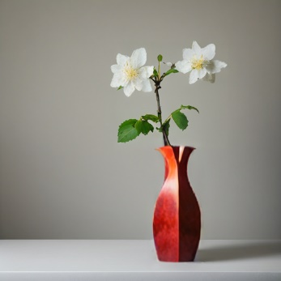
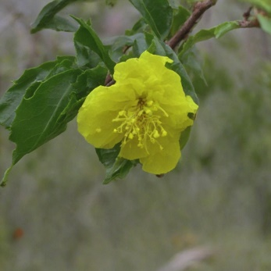

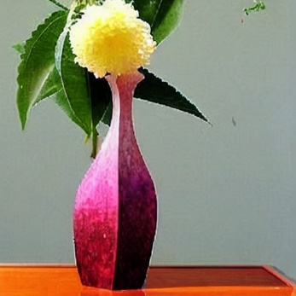
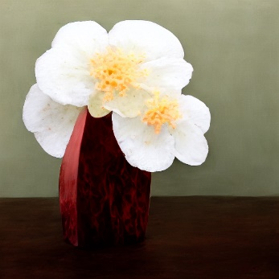
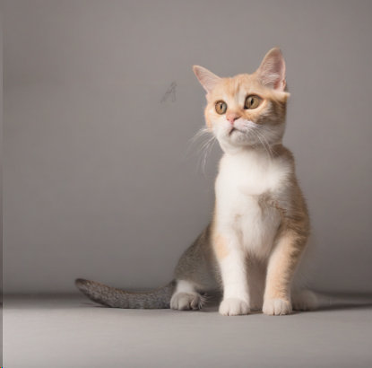
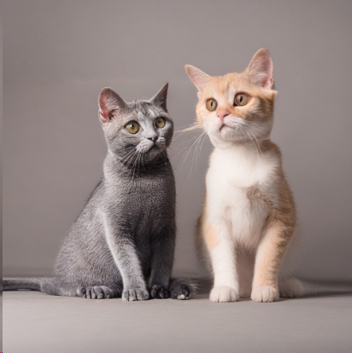
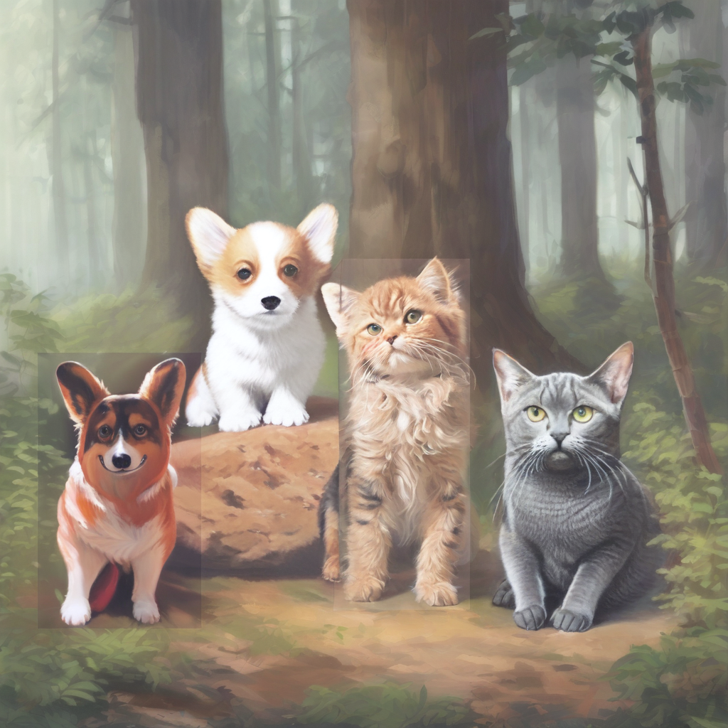
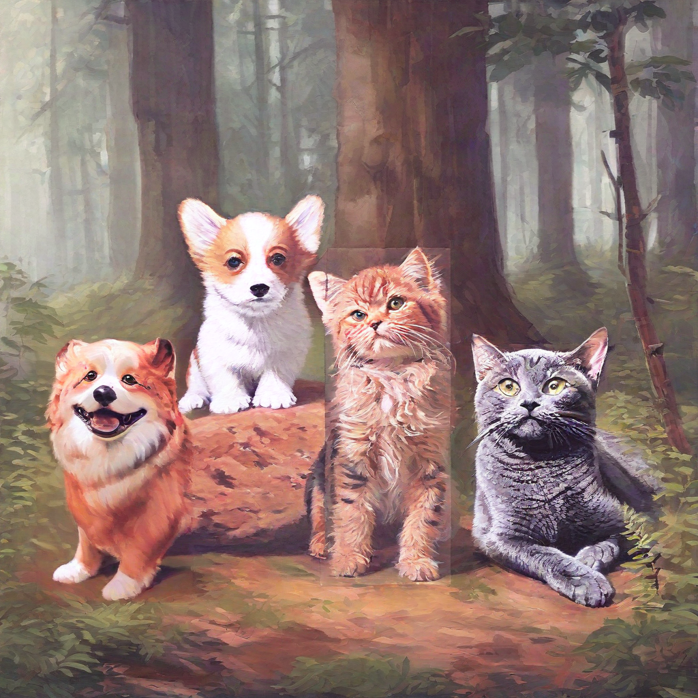
OneCAT – One Concept A Time
Bo-Rui Chen¹, Chun-Huan Chou¹, Shao-Xiang Yuan¹, Ye-Shin Yang²
(B10901028, B10901025, B11901055, B10508026)
¹National Taiwan University Department of Electrical Engineering
²National Taiwan University Department of Biomedical Engineering
(1) Textual Inversion Training
Pretrained Model
Learned Embeddings
<dog>
Stable Diffusion
XL
<dog6>
<dog>
<dog6>
<pet_cat1>
<pet_cat1>
(2) Custom Image Generation Pipeline
2. Object detection for mask generation
Initial image generation with validation prompt
Initial Image
Detection Model
Mask
OWLv2
dog
dog
A dog, a cat and a dog near a forest.
Stable Diffusion
XL
cat
3. Concept object(s) inpainting
<dog6>
Stable Diffusion
XL
<pet_cat1>
<dog>
<dog6>
<dog>
<pet_cat1>
Initial Image
Step1
Step2
Step3
Final Image
Introduction
Results
Ablation Studies
Current multi-concept personalization methods suffer from blending similar concepts, such as cats and dogs, which results in mixed features or the omission of certain concepts. To address this issue, we propose One Concept-A-Time (One CAT), a method that separates the generation of each concept to avoid blending while maintaining the natural and harmonious appearance of the entire image.
Only use textual inversion
Dog
Cat
Figure4. (left) Generate two cats instead of a cat and a dog.
Figure5. (middle,right) Attention map for stable diffusion2 model.
Methods
Using segmentation instead of detection
Our pipeline consists of three steps:
Draft Generation: Similar to how humans sketch, we first create a "draft" using dummy tokens (e.g., "cat") to represent each concept.
Mask Generation: Using a fast zero-shot object detection method, we generate binary masks to identify the regions of interest (bounding boxes of the dummy objects).
Inpainting: With the masks, we perform inpainting to sequentially replace the dummy objects with the refined concepts generated via textual inversion.
Figure2. CLIP score comparison across different methods
OneCAT
Textual Inversion
Lambda
Eclipse
Custom Diffusion
Free Custom
Figure6. (left) Segmentation result for the dog.
Figure7. (Right) Inpainting based on segmentation results.
A “<cat2>” on the right and a “<dog6> on the left.
Adjusting Inpainting Hyperparameters.
A “<flower_1>” in a “<vase>”
Figure8. w/o and w/ Mask padding crop and Negative prompts
Figure3. Comparison between each methods
Discussions
Advantages
Limitations
Our Method | Effect
Object detection | Preventing merging between concepts
Inpainting | Concepts blend seamlessly with the scene
Not model-specific | Can use any diffusion model with its textual inversions
Cause | Effect | Improvement
Complex Commands | Concepts vanish | Find better dummy tokens
Inpainting Failure | Concepts vanish | Negative prompts and mask padding
Multiple Inpainting steps | Slower inference time | Inpaint simultaneously for disjoint masks
“A <dog>, a <dog6>, a <cat2>” and a <cat> near a forest.
Figure1. We can also generate four distinct concepts in the image.
Reference:
Gal, Rinon, et al. "An image is worth one word: Personalizing text-to-image generation using textual inversion." arXiv preprint arXiv:2208.01618 (2022).
Ding, Ganggui, et al. "FreeCustom: Tuning-Free Customized Image Generation for Multi-Concept Composition." Proceedings of the IEEE/CVF Conference on Computer Vision and Pattern Recognition. 2024.
Podell, Dustin, Kumari, Nupur, et al. "Multi-concept customization of text-to-image diffusion." Proceedings of the IEEE/CVF Conference on Computer Vision and Pattern Recognition. 2023.
et al. "Sdxl: Improving latent diffusion models for high-resolution image synthesis." arXiv preprint arXiv:2307.01952 (2023).
Patel, Maitreya, et al. "$\lambda $-ECLIPSE: Multi-Concept Personalized Text-to-Image Diffusion Models by Leveraging CLIP Latent Space." arXiv preprint arXiv:2402.05195 (2024).
Minderer, Matthias, Alexey Gritsenko, and Neil Houlsby. "Scaling open-vocabulary object detection." Advances in Neural Information Processing Systems 36 (2024).

